Slide 1
Hi! This is CS50.
Welcome back!
Rice Krispies Treats for break today.
CS50 Lunch this Fri 10/25, 1:15pm, RSVP at cs50.harvard.edu/lunch to attend.
If you have trouble seeing projector, see live.cs50.io/screen for live feed.
Quiz 6 due tomorrow at 10:30am.
Problem Set 6 due Sun 10/27 at 11:59pm.
Supersection tonight at 7:30pm via Zoom.
Lots of tutorials available this week!
Notes:
https://www.youtube.com/watch?v=Aut32pR5PQA

Slide 2
This is CS50

Slide 3
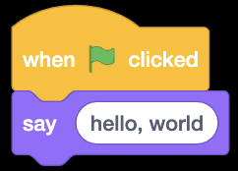

Slide 4
#include <stdio.h>
int main(void) {
printf("hello, world\n");
}

Slide 5
print("hello, world")

Slide 6
make hello
./hello

Slide 7
clang -o hello hello.c -lcs50
./hello

Slide 8
python hello.py
Notes:
hello.py

Slide 10
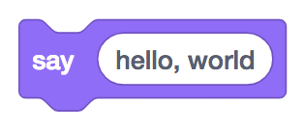
printf("hello, world");

Slide 11
printf("hello, world\n");;

Slide 12
print("hello, world");

Slide 14
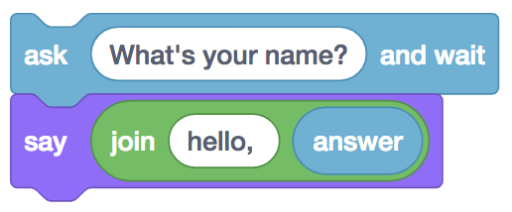
string answer = get_string("What's your name?\n");
printf("hello, %s\n", answer);

Slide 15
string answer = get_string("What's your name?\n");
printf("hello, %s\n", answer);

Slide 16
answer = get_string("What's your name?\n")
print("hello, " + answer)

Slide 17
answer = get_string("What's your name?\n")
print("hello, " + answer)

Slide 18
answer = get_string("What's your name?\n")
print("hello, " + answer)

Slide 19
answer = get_string("What's your name?\n")
print("hello,", answer)

Slide 20
answer = get_string("What's your name?\n")
print(f"hello, {answer}")

Slide 22
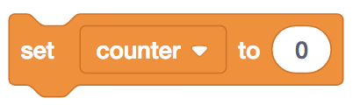
int counter = 0;

Slide 23
int counter = 0;

Slide 24
counter = 0

Slide 25
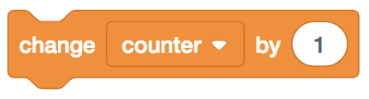
counter = counter + 1;

Slide 26
counter = counter + 1;

Slide 27
counter = counter + 1

Slide 28
counter += 1;

Slide 29
counter += 1;

Slide 30
counter += 1

Slide 32
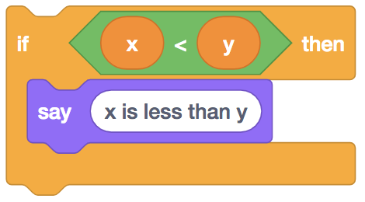
if (x < y) {
printf("x is less than y\n");
}

Slide 33
if (x < y) {
printf("x is less than y\n");
}

Slide 34
if x < y:
print("x is less than y")

Slide 36
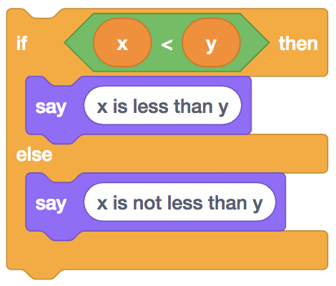
if (x < y) {
printf("x is less than y\n");
}
else
{ printf("x is not less than y\n");
}

Slide 37
if (x < y) {
printf("x is less than y\n");
}
else
{ printf("x is not less than y\n");
}

Slide 38
if x < y:
print("x is less than y")
else: print("x is not less than y")

Slide 40
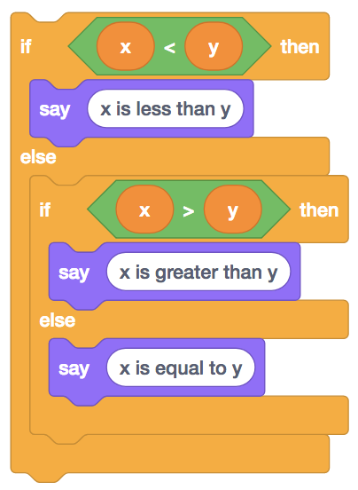
if (x < y) {
printf("x is less than y\n");
}
else if (x > y)
{ printf("x is greater than y\n");
}
else
{ printf("x is equal to y\n");
}

Slide 41
if (x < y) {
printf("x is less than y\n");
}
else if (x > y)
{ printf("x is greater than y\n");
}
else
{ printf("x is equal to y\n");
}

Slide 42
if x < y:
print("x is less than y")
elif x > y: print("x is greater than y")
else: print("x is equal to y")

Slide 44
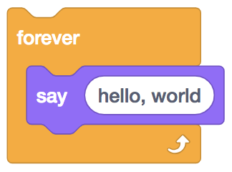
while (true)
{
printf("hello, world\n");
}

Slide 45
while (true)
{
printf("hello, world\n");
}

Slide 46
while True:
print("hello, world")

Slide 48
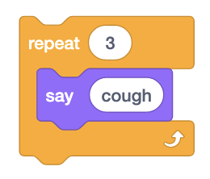
for (int i = 0; i < 50; i = i + 1)
{
printf("hello, world\n");
}

Slide 49
int i = 3;
while (i > 0)
{
printf("cough\n");
i--;
}

Slide 50
i = 3
while i > 0:
print("cough")
i -= 1

Slide 51
for (int i = 0; i < 50; i = i + 1)
{
printf("hello, world\n");
}

Slide 52
for (int i = 0; i < 3; i++)
{
printf("cough\n");
}

Slide 53
for i in [0, 1, 2]:
print("cough")

Slide 54
for i in range(3):
print("cough")

Slide 55
bool
char
double
float
int
long
string
...

Slide 56
bool
float
int
str
...

Slide 57
range sequence of numbers
list sequence of mutable values
tuple sequence of immutable values
dict collection of key-value pairs
set collection of unique values
...

Slide 58
range sequence of numbers
list sequence of mutable values
tuple sequence of immutable values
dict collection of key-value pairs
set collection of unique values
...

Slide 59
range sequence of numbers
list sequence of mutable values
tuple sequence of immutable values
dict collection of key/value pairs
set collection of unique values
...

Slide 60
range sequence of numbers
list sequence of mutable values
tuple sequence of immutable values
dict collection of key/value pairs
set collection of unique values
...

Slide 61
range sequence of numbers
list sequence of mutable values
tuple sequence of immutable values
dict collection of key-value pairs
set collection of unique values
...

Slide 62
range sequence of numbers
list sequence of mutable values
tuple sequence of immutable values
dict collection of key-value pairs
set collection of unique values
...

Slide 63
docs.python.org
Notes:
filter
speller

Slide 64
get_char
get_double
get_float
get_int
get_long
get_string
...

Slide 65
get_float
get_int
get_string

Slide 66
#include <cs50.h>

Slide 67
import cs50

Slide 68
from cs50 import get_float, get_int, get_string

Slide 69
input

Slide 70
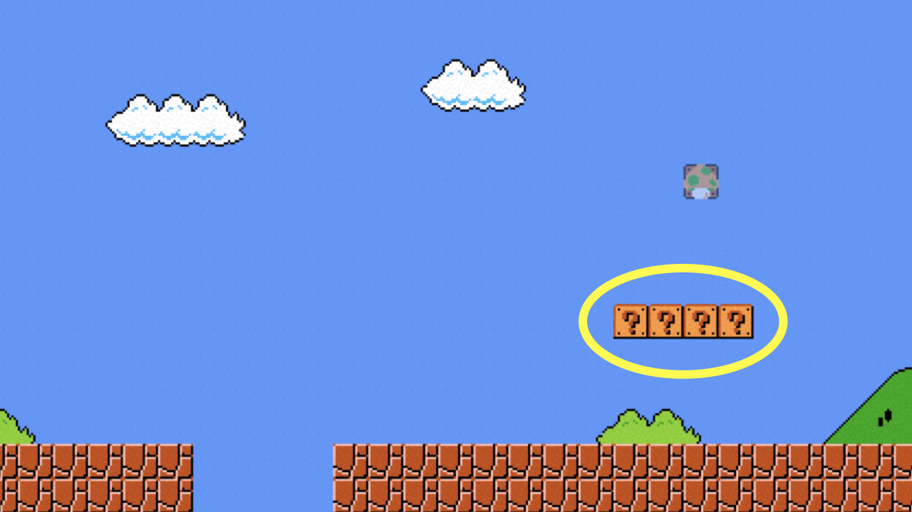

Slide 71
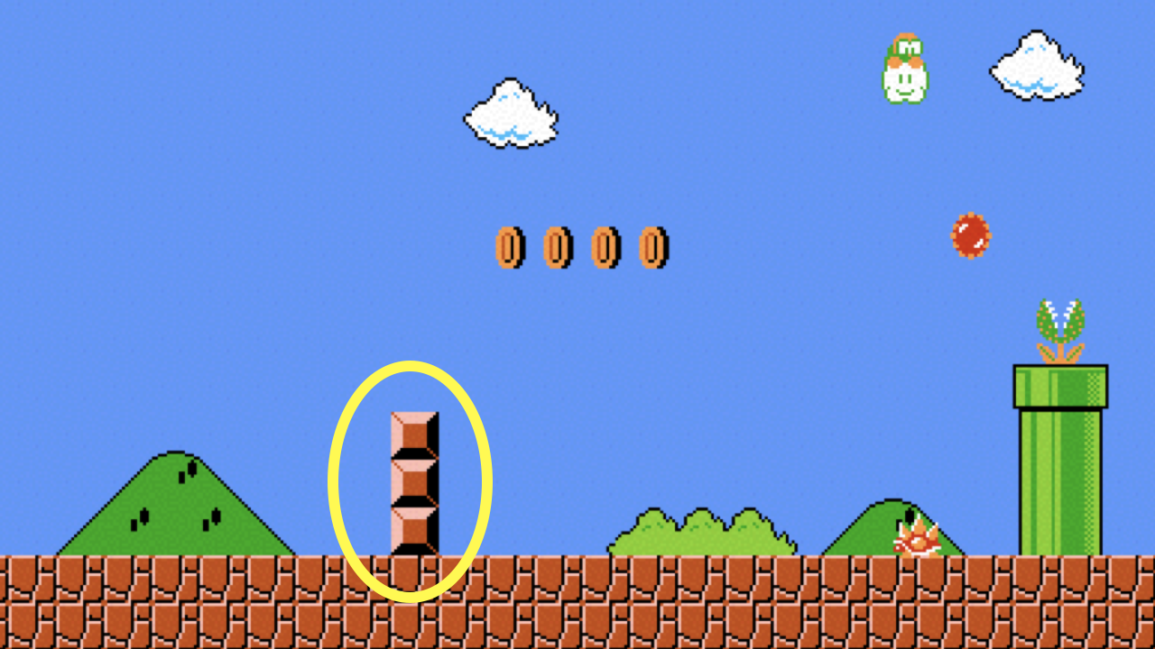

Slide 72
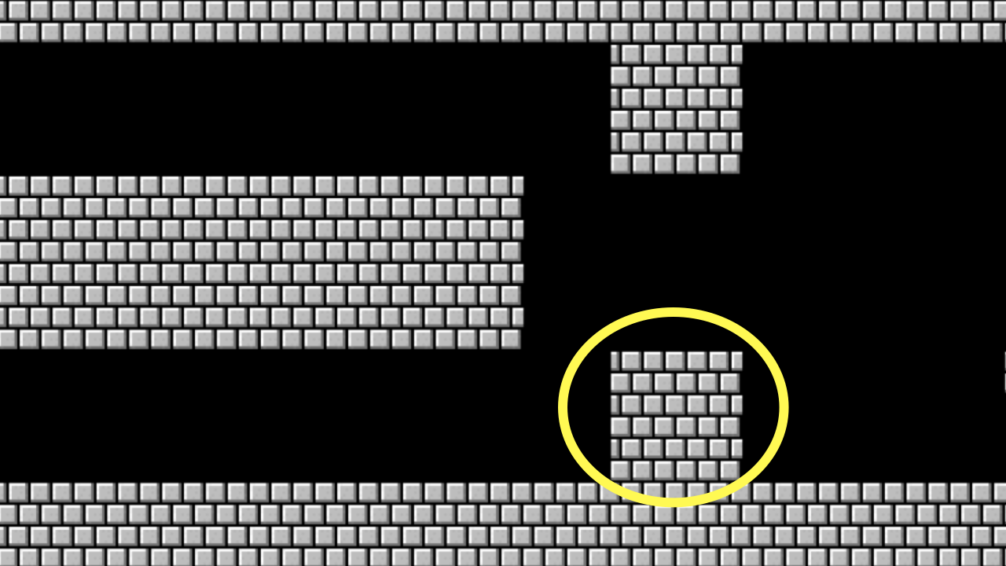

Slide 73
floating-point imprecision
Notes:
1.0 / 10.0

Slide 74
integer overflow

Slide 75
integer overflow

Slide 76
regular expressions

Slide 77
. any character
.* 0 or more characters
.+ 1 or more characters
? optional
^ start of input
$ end of input
...
Notes:
agree2.py

Slide 78
This is CS50

